Slide 1
3D indoor models for the fire department
An investigation of the possibilities
Internship at Veiligheidsregio Rotterdam Rijnmond
Department Research & Analysis

Slide 2
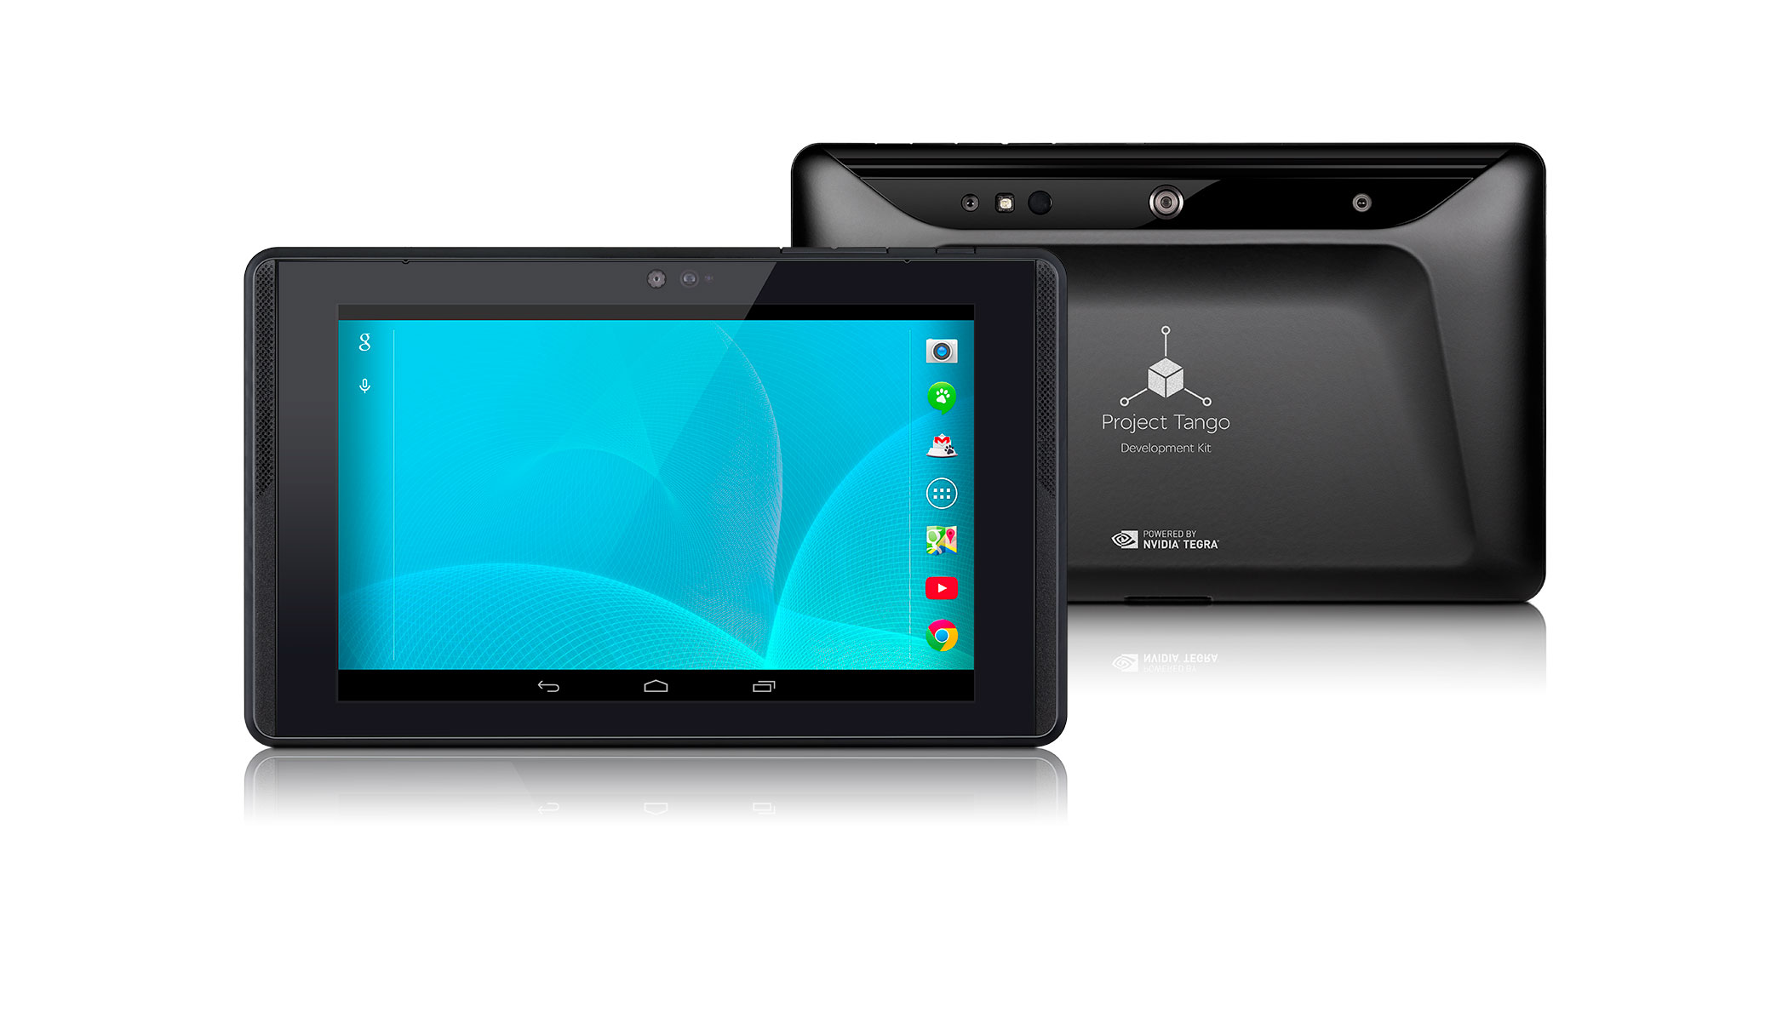
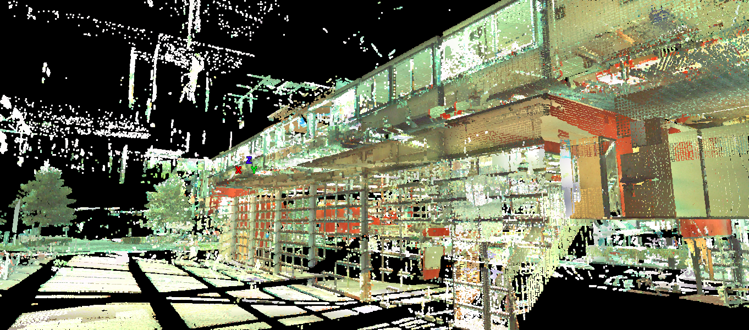
SIms3D
Developing fast methods to produce smart indoor 3D models

Slide 3
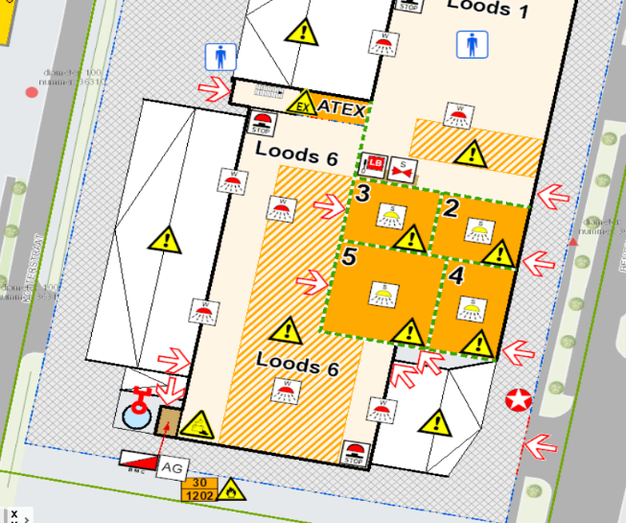
Upgrade for MOI

Slide 4
Research targets
What are 3D-indoor models?
How does the fire department work?
How can 3D-indoor models be applied?

Slide 5
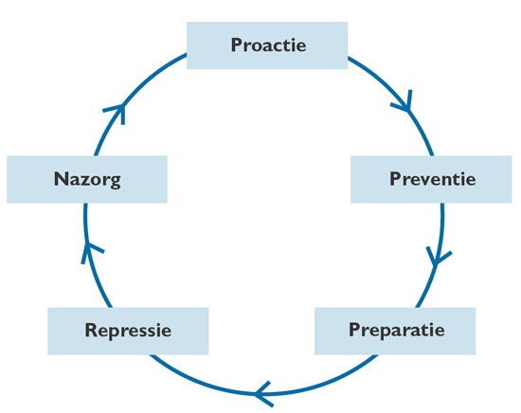
Methods
Literature
Many interviews
Broad approach

Slide 6
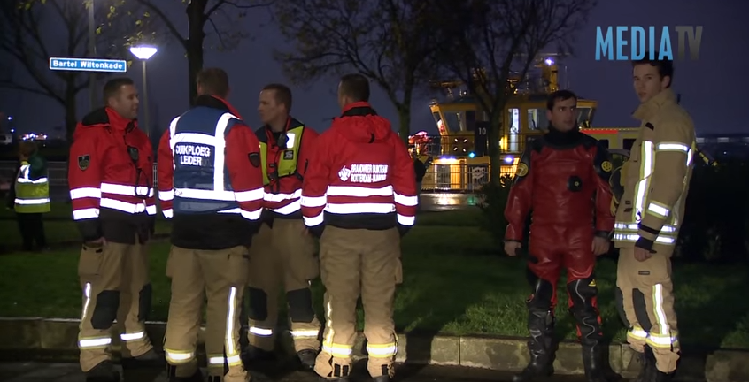
24-hours shift
Showed me the importance of quick and intuitive information supply

Slide 7
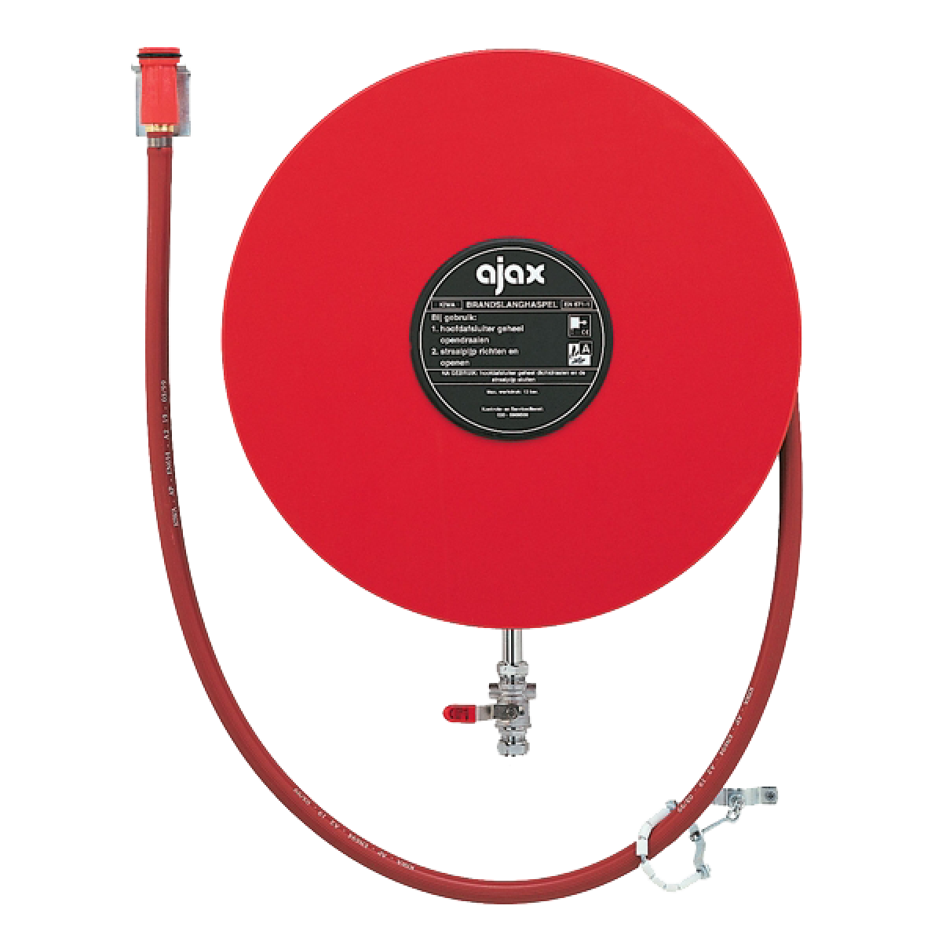
Prevention
Building state changes constantly
3D-overview of prevention measures

Slide 8
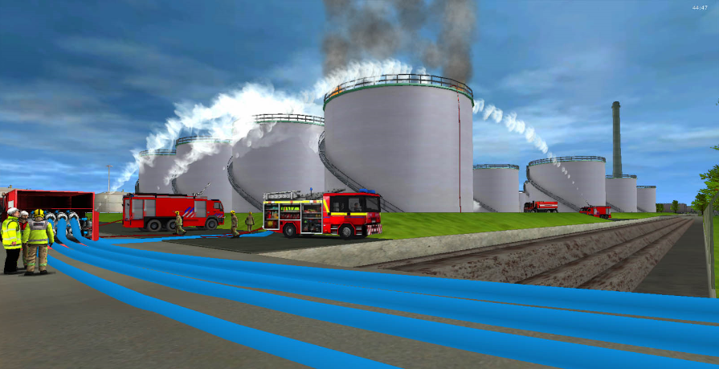
Preparation
Virtual trainings in real buildings
Making attack plans

Slide 9
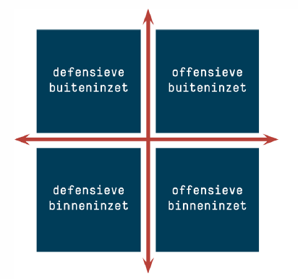
Repression 1/2
Indoor tracking
Choosing a strategy

Slide 10
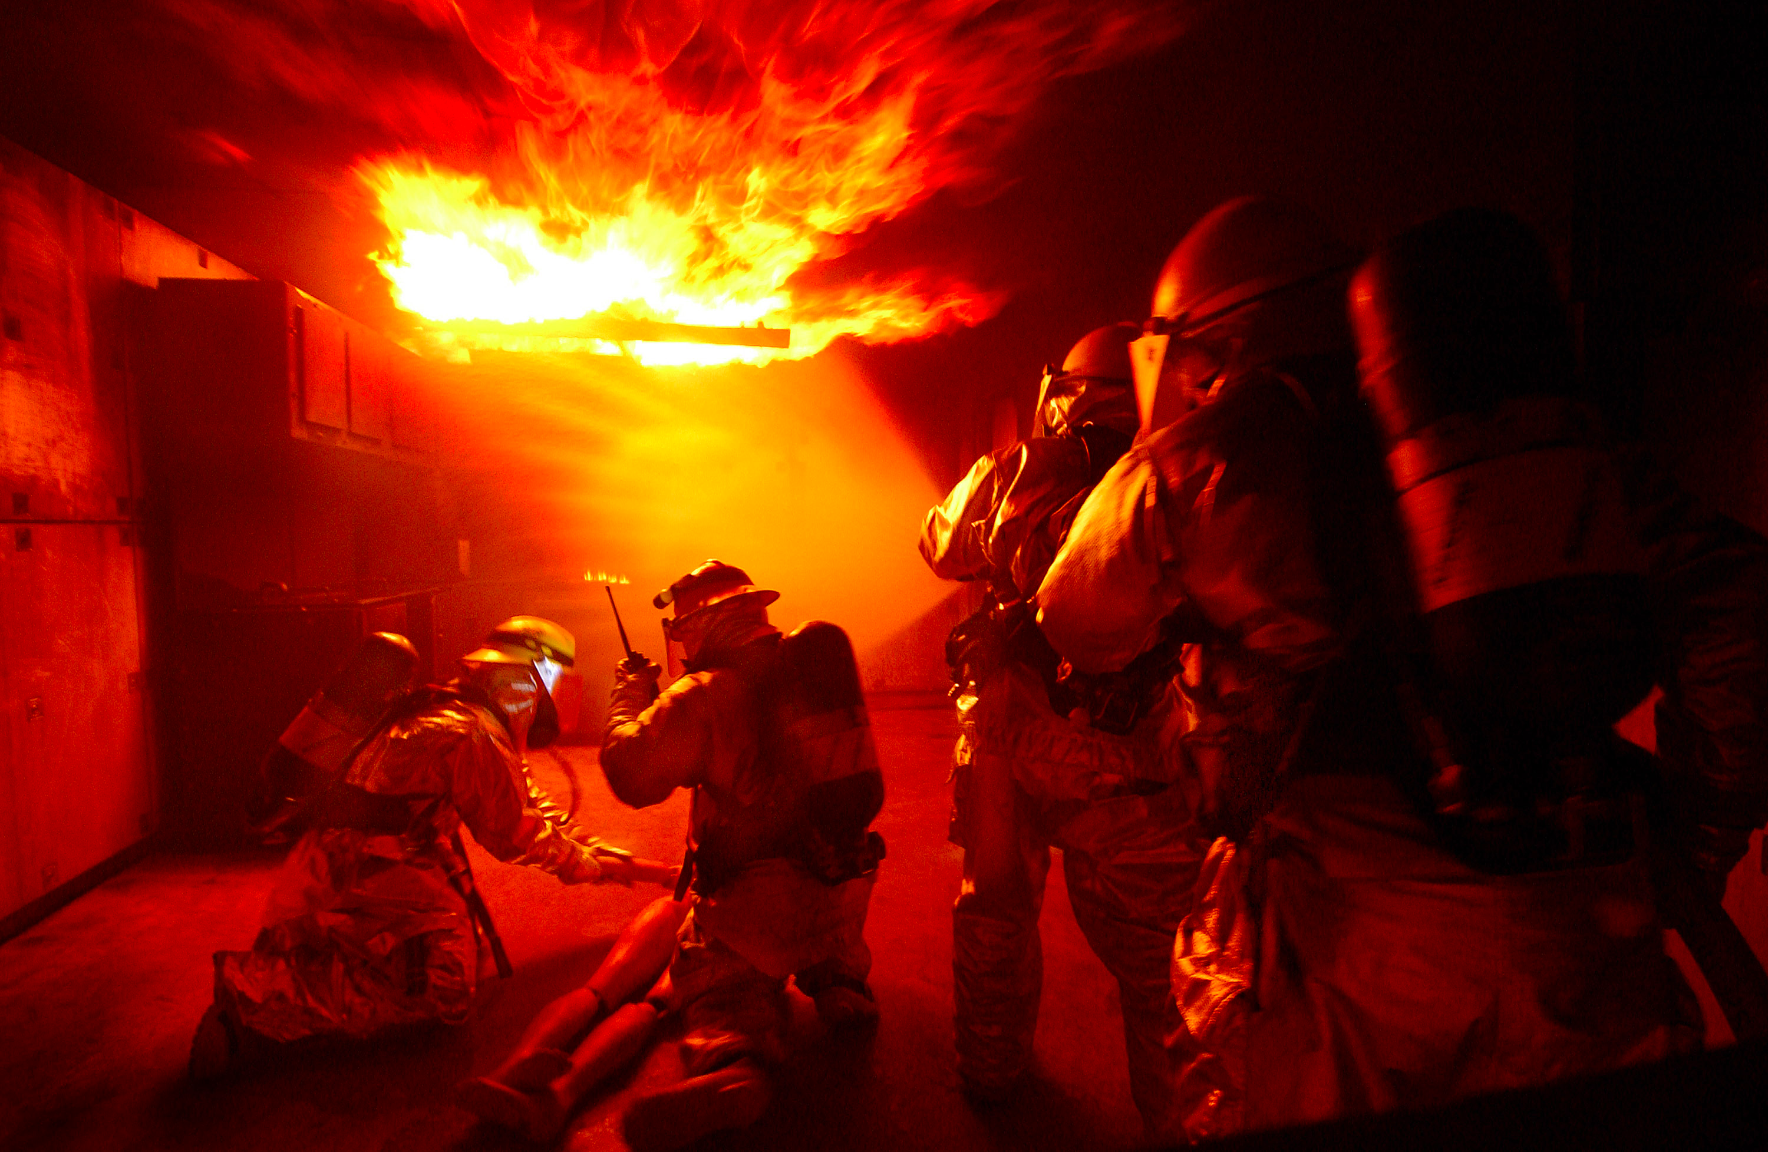
Repression 2/2
Finding important items
Indoor navigation zero sight

Slide 11
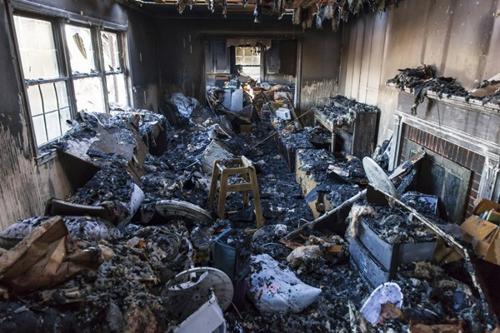
Aftercare
Fire research: seeing the pre-fire state of the building

Slide 12
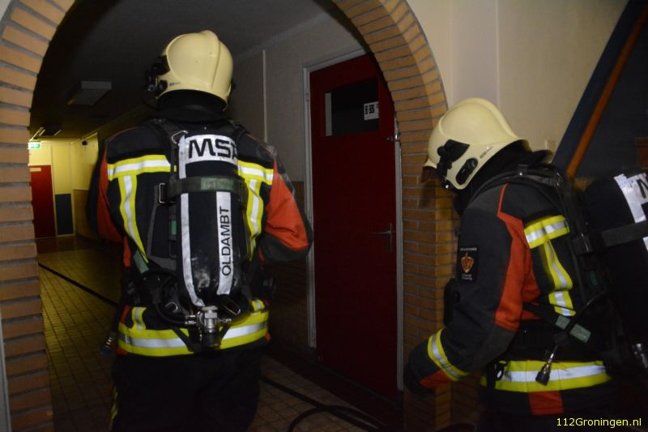
Different opinions
Same targets, different approaches
Old school VS New school
Different levels of trust in models

Slide 13
Complex development
Upgrades needed in:
Software
Hardware
Humanware (training)

Slide 14
Research Conclusion
Much effort and money needed, but it will be worth it!
Making the Netherlands a safer place

Slide 15
Linking Sims3D with firedepartment
Forming a link between two organisations:
Informing SIMs3D about the fire department
Informing the fire department about 3D-indoor

Slide 16
What went well?
Got to know the organization quickly
Made a broad overview
Everyone was cooperative

Slide 17
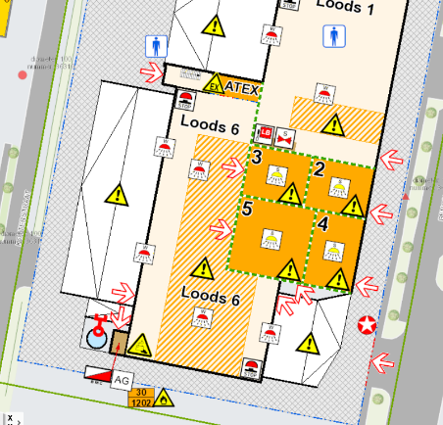
What could have went better?
- Small ‘clash’ with the makers of the MOI

Slide 18
What I liked most
Working with passionate people
Contributing to something important

Slide 19
What I would have liked
- Building more technical skill in 3D

Slide 20
Great experience
Thanks for your attention

